Slide 1


Team 6: Telescope Autofocuser
Albin Myscich
Alonna Too-Chiobi
Camille Watson
Joseph Basdeo
Sponsor: Dr. Kevin Nowka
TA: Max Lesser
Notes:
Michelle

Slide 2
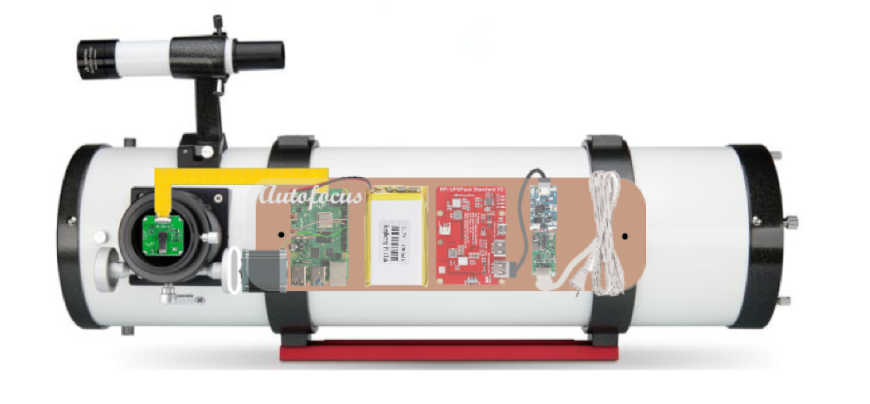
Project Summary
Telescope focusing & image processing automation
Product Will:
Stream current images to dev board using an imager
Autofocus using a stepper motor interface
Display focused image post processing through a GUI
Notes:
Kyle

Slide 3
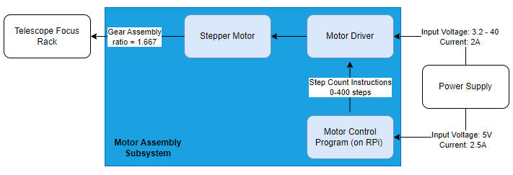
Motor Assembly Subsystem
Alonna Too-Chiobi
Block Diagram
Read rotation instructions determined by the Image Processing Program
Executes precise rotations in clockwise and counterclockwise directions
Convert electrical energy into mechanical energy used to rotate the telescope focuser rack

Slide 4
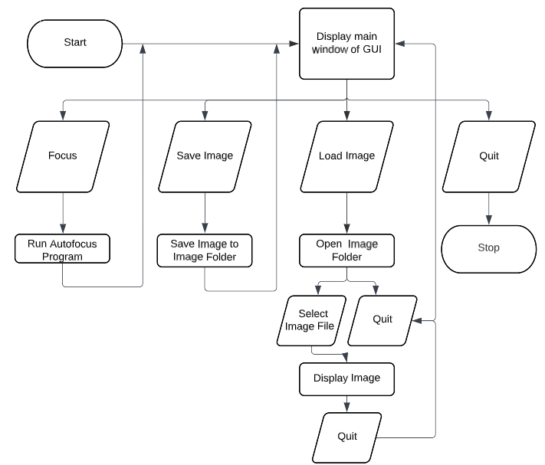
Imager & GUI Subsystem
Joseph Basdeo
GUI Block Diagram
Specifications:
Stream image data to autofocusing program in form of video or picture
Capture low light images of astronomical objects
Load and display captured images from image folder directory
Mounting assembly must be able to be positioned and removed without damaging telescope or other components

Slide 5
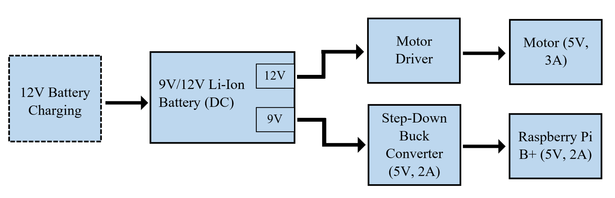
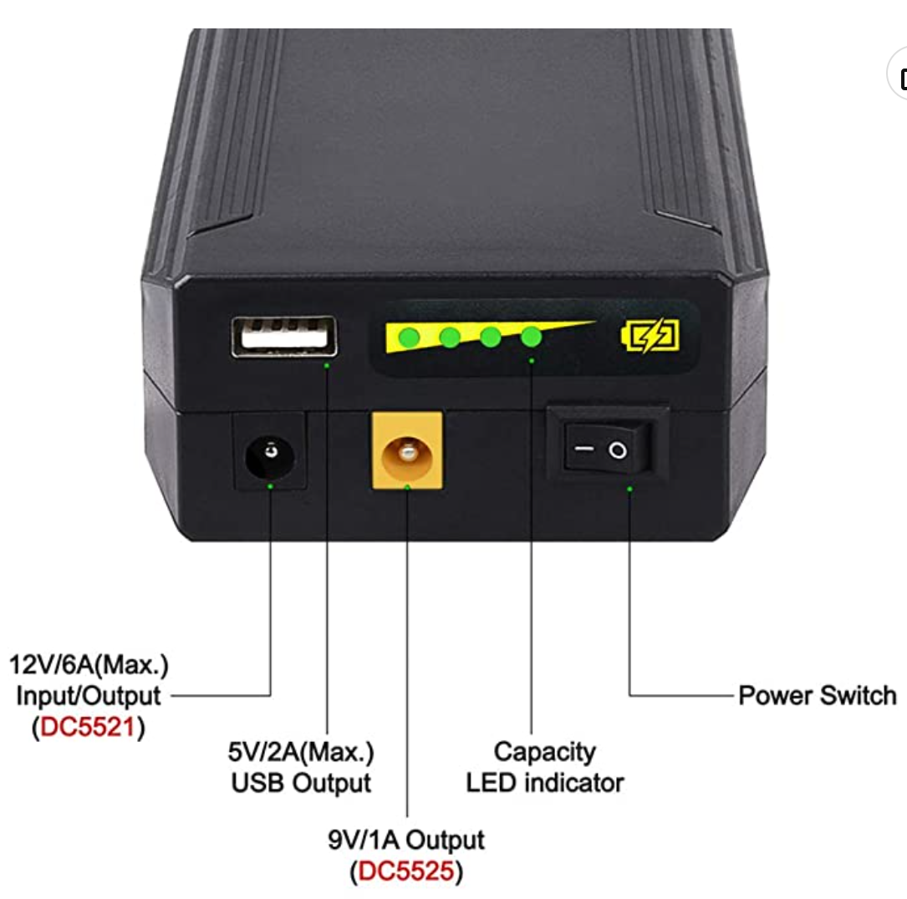
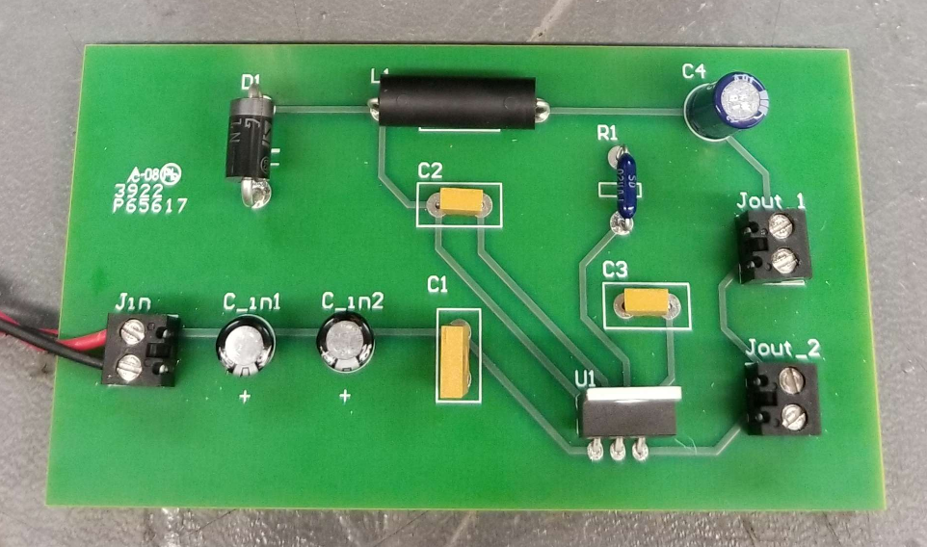
Power Subsystem
Camille Watson
Block Diagram
9V/12V Li-Ion Battery
5V/2A Step-Down Buck Converter PCB
Specifications:
Provide power to the two loads (motor driver and Raspberry Pi B+)
Step down and regulate the 9V output so that 5V are flowing into Raspberry Pi B+
Provide 12V directly from battery to supply motor driver

Slide 6
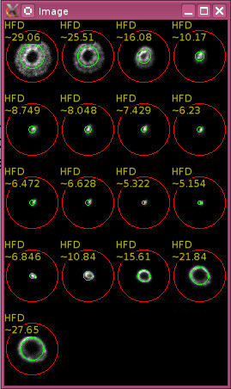
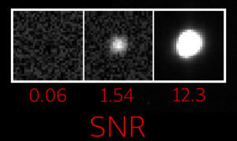
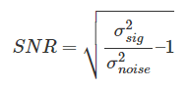
Autofocuser & Img. Optimization Subsystem
Albin Kyle Myscich
Pre-processing
SNR possible if noise is measured
e.g. in background or noise is known
Background std. difficult to assess
Estimated with variance_noise() in
CImag library
Deliverable | Met
Stars can distinguished from background noise | Yes

Slide 7
Q/A

